Slide 1


ENERGY EFFICIENCY SMART BUILDINGS
PIPASHA . S
SUNMATHI . R
NASEEMA BANU . S
NIVETHA . M
SHALINI . R

Slide 2
Content
Abstract
Problem Statement
Objective
Data Collection and Preparation
Proposed Solution (Methodology)
Model Performance Evaluation
Screenshots / Demonstration (video)
Future Scope
Conclusion
Notes:
Abstract
Problem Statement (Clearly define the challenge)
Objective (State your project's goal)
Background and Research (Discuss existing solutions, trends, and gaps)
Data Collection and Preparation (Focus on data sources, cleaning, and augmentation)
Proposed Solution (Methodology)
Model Architecture (e.g., CNN, U-Net, YOLOv5)
Key Techniques (e.g., Transfer Learning, Image Augmentation)
Model Performance Evaluation
Metrics (Accuracy, Precision, Recall, IoU, etc.)
Graphs (Confusion Matrix, ROC Curve, etc.)
Screenshots / Demonstration (Visual proof of system functionality)
Future Scope (Improvements, scalability, and integration ideas)
Conclusion (Summarize results and impact)
Q&A Session

Slide 3
Abstract
• Buildings contribute to 40% of global energy consumption.
• AI-driven energy management can optimize usage and reduce costs.
• Case study: AI-based HVAC optimization in Singapore reduced energy usage by 20%.

Slide 4
Problem Statement
• High energy consumption in commercial buildings.
• Inefficient heating, ventilation, and cooling systems.
• Need for sustainable solutions to reduce operational costs and environmental impact

Slide 5
Objective
• Improve energy efficiency in smart buildings using AI.
• Optimize HVAC and other systems based on real-time data.
• Reduce energy costs and carbon footprint.

Slide 6
Data Collection and Preparation
Dataset Includes:
• Building energy usage data
• Occupancy levels
• Weather conditions over two years
Data Preprocessing:
• Handling missing values
• Normalization & scaling
• Feature selection

Slide 7
Proposed Solution (Methodology)
• Use AI & machine learning to analyse energy consumption.
• Implement predictive modelling using:
- Regression models
- Deep learning (ANNs, CNNs for pattern recognition)
• Optimize HVAC systems based on real-time occupancy & weather data.

Slide 8
Model Performance Evaluation
Metrics Used:
• Mean Absolute Error (MAE)
• Mean Squared Error (MSE)
• R-squared (R²) Score
Comparison with traditional rule-based systems.

Slide 9
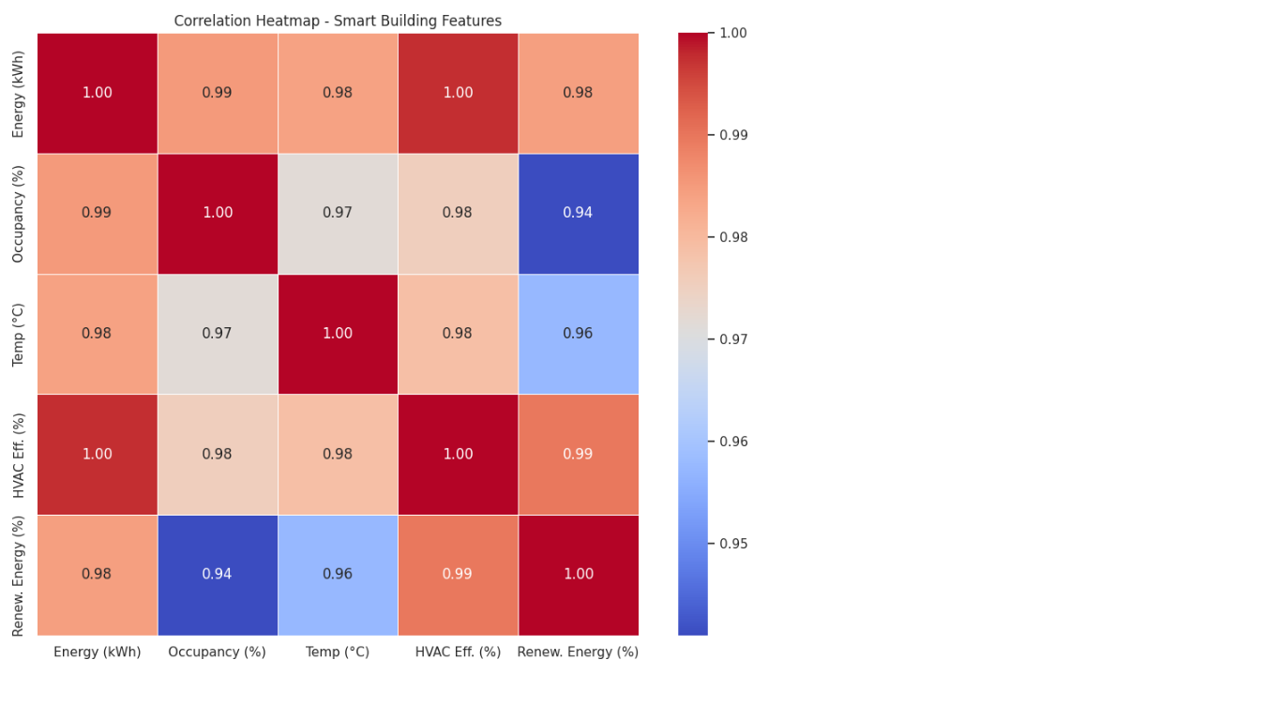
Screenshots / Demonstration (video)
Colab Link: https://colab.research.google.com/drive/1q8uQaQhDRtwSbTPOLPUfOENEBWg5wAM6
Github link: https://github.com/pipasha123456/S4F_CP_Team_12272/upload/main

Slide 10
Future Scope
• Integration with IoT for real-time energy management.
• Expansion to residential buildings & smart cities.
• Use of renewable energy sources combined with AI optimization.

Slide 11
Conclusion
• AI-powered energy management reduces costs & carbon footprint.
• Significant energy savings in commercial buildings.
• Future advancements can enhance sustainability efforts worldwide.

